Slide 1
UNIT 3
Linear Regression -Relation between two variables – Steps – Evaluation –
Logistic Regression – Decision Tree – Algorithms – Construction – Classification using Decision Tree – Issues – Rule-based Classification – Pruning the Rule Set – Support Vector Machines – Linear SVM – Optimal Hyperplane – Radial Basis Functions – Naïve Bayes Classifier – Bayesian Belief Networks.

Slide 2
Linear regression is a type of supervised machine learning algorithm that computes the linear relationship between a dependent variable and one or more independent features. When the number of the independent feature, is 1 then it is known as Univariate Linear regression, and in the case of more than one feature, it is known as multivariate linear regression.
Types of Linear Regression
Simple Linear Regression
Multiple Linear Regression
Polynomial Regression
Simple Linear Regression
Formula: y = mx + b
Explain each component: y (dependent variable), x (independent variable), m (slope), b (y-intercept)
Multiple Linear Regression
Formula: y = b0 + b1x1 + b2x2 + ... + bnxn
Explain each component: y (dependent variable), x1, x2, ..., xn (independent variables), b0 (intercept), b1, b2, ..., bn (coefficients)
Polynomial Regression
Formula: y = b0 + b1x + b2x^2 + ... + bnx^n
Explain each component: y (dependent variable), x (independent variable), b0 (intercept), b1, b2, ..., bn (coefficients)

Slide 3
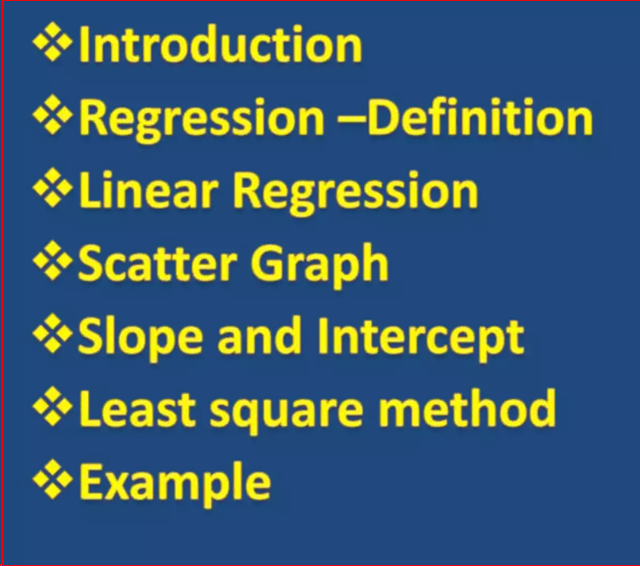

Slide 4
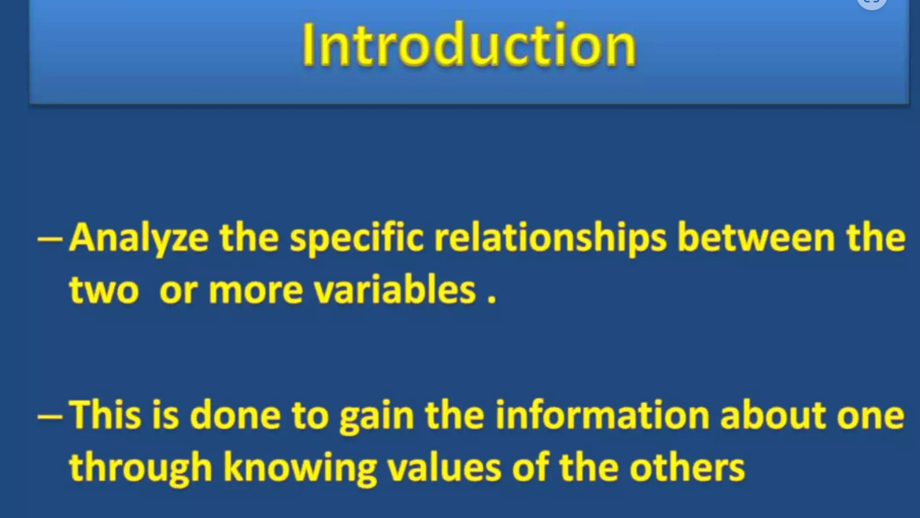

Slide 5
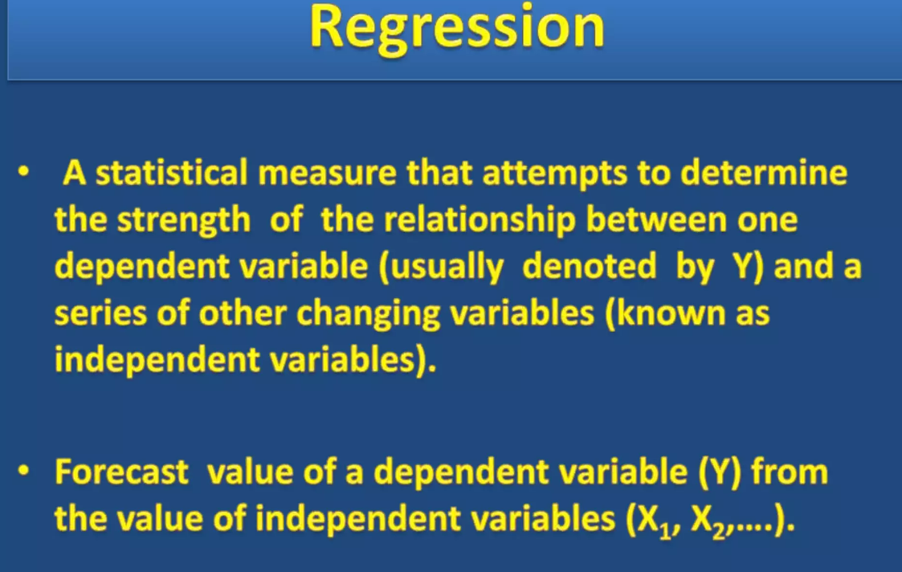

Slide 6
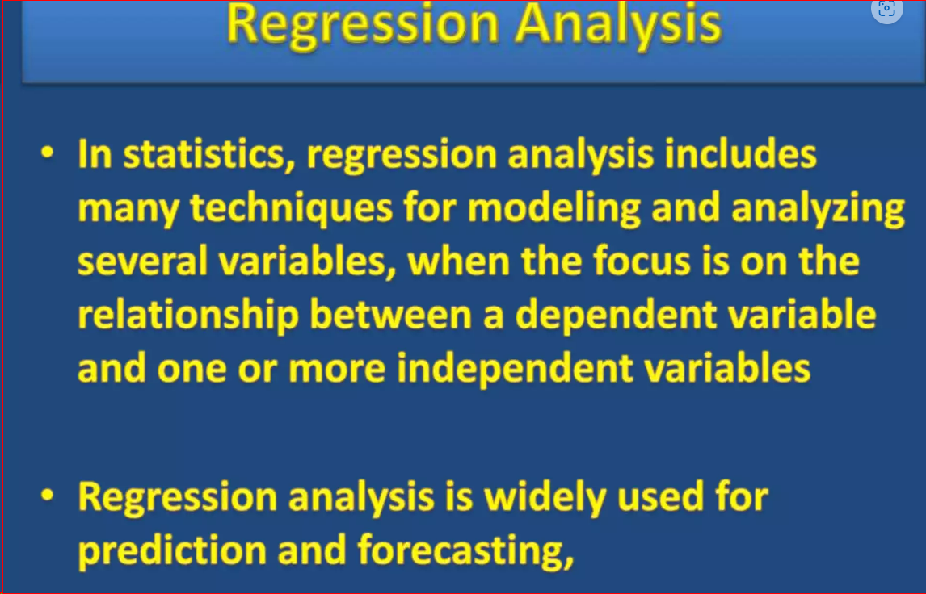

Slide 7
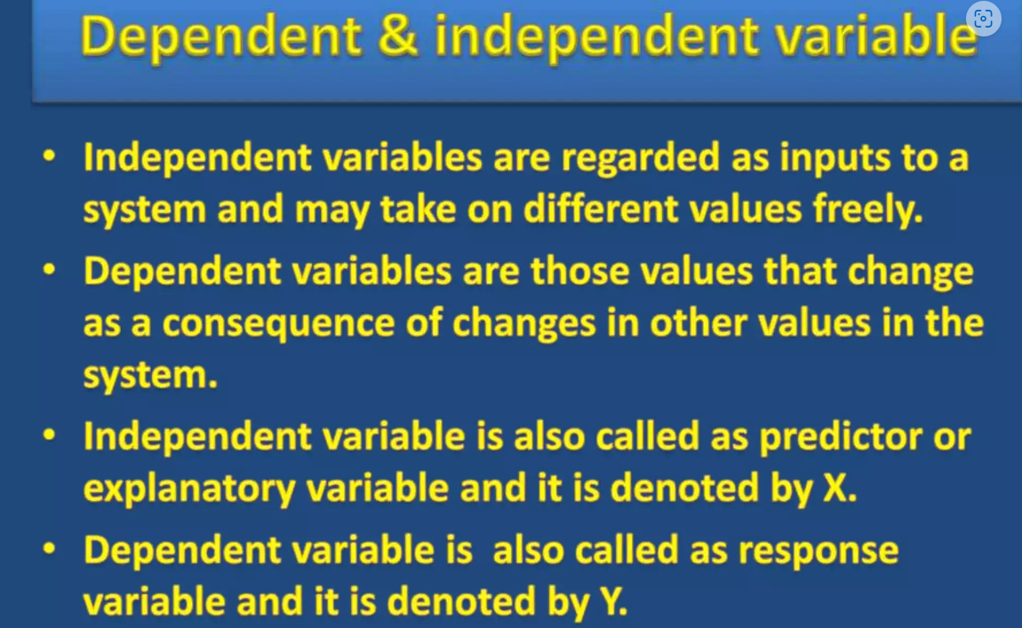

Slide 8
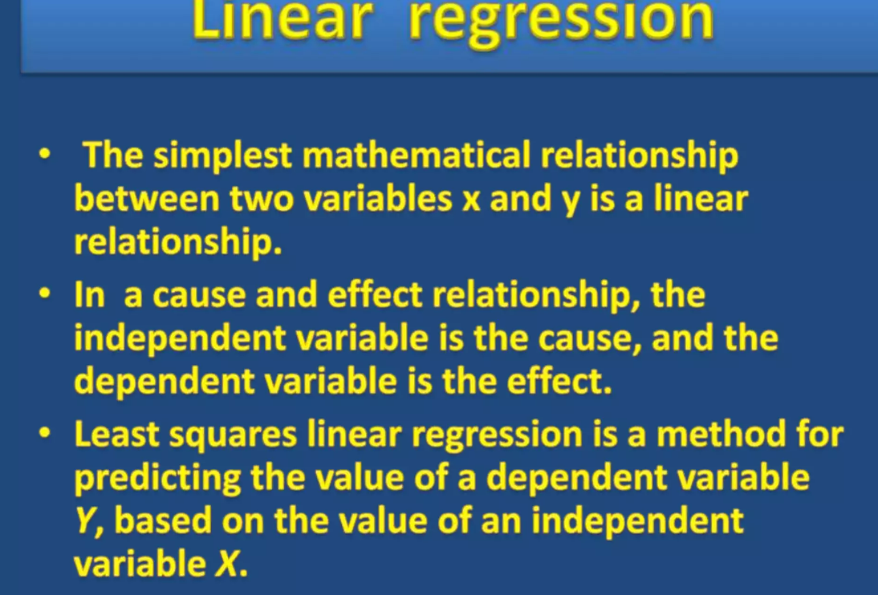

Slide 9
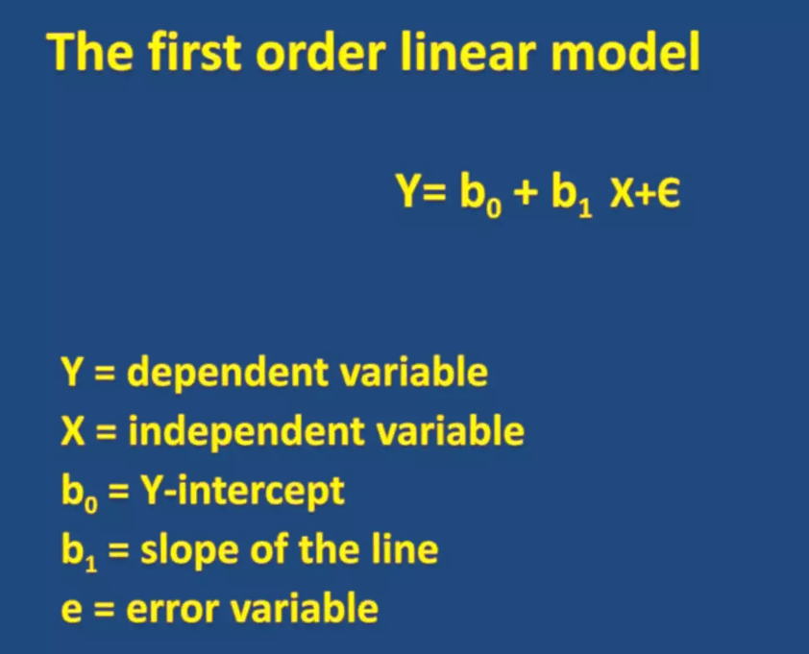

Slide 10
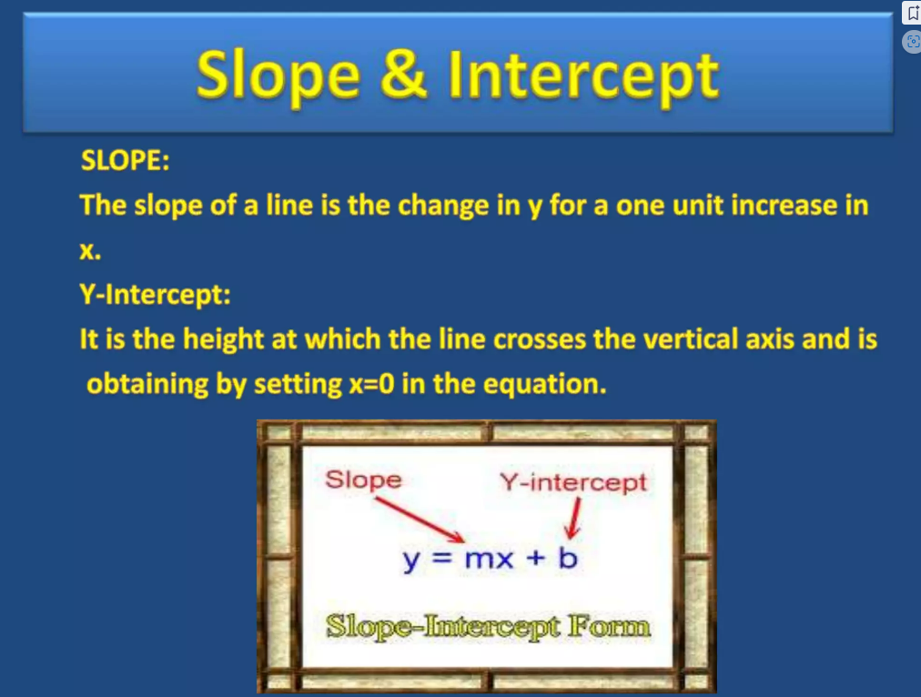

Slide 11
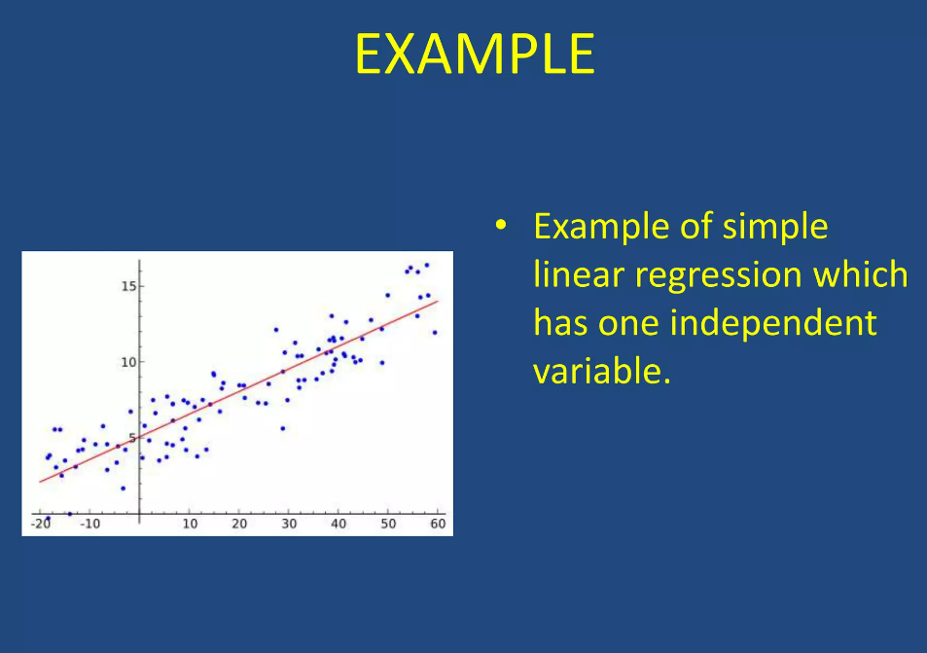

Slide 12
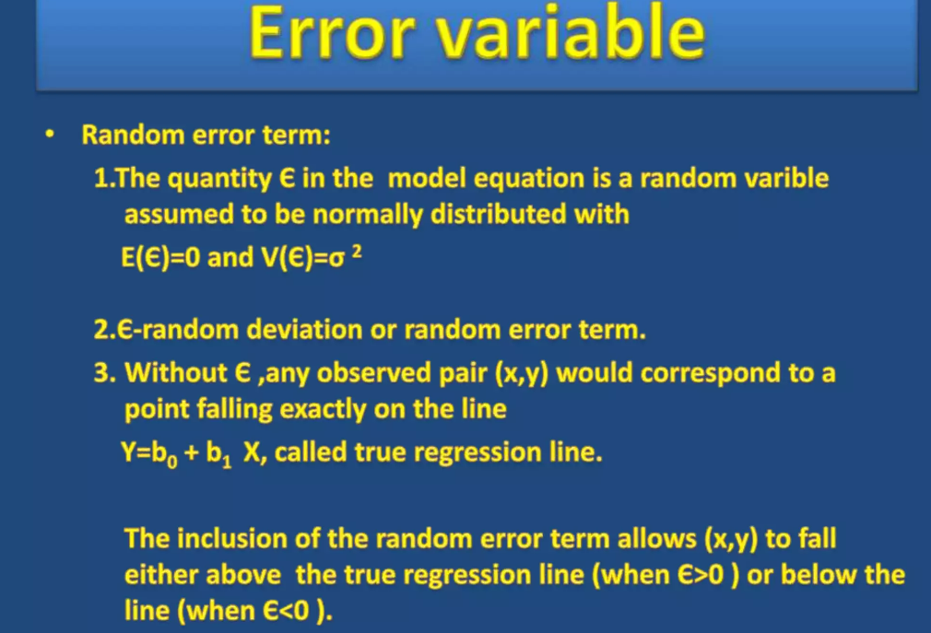

Slide 13
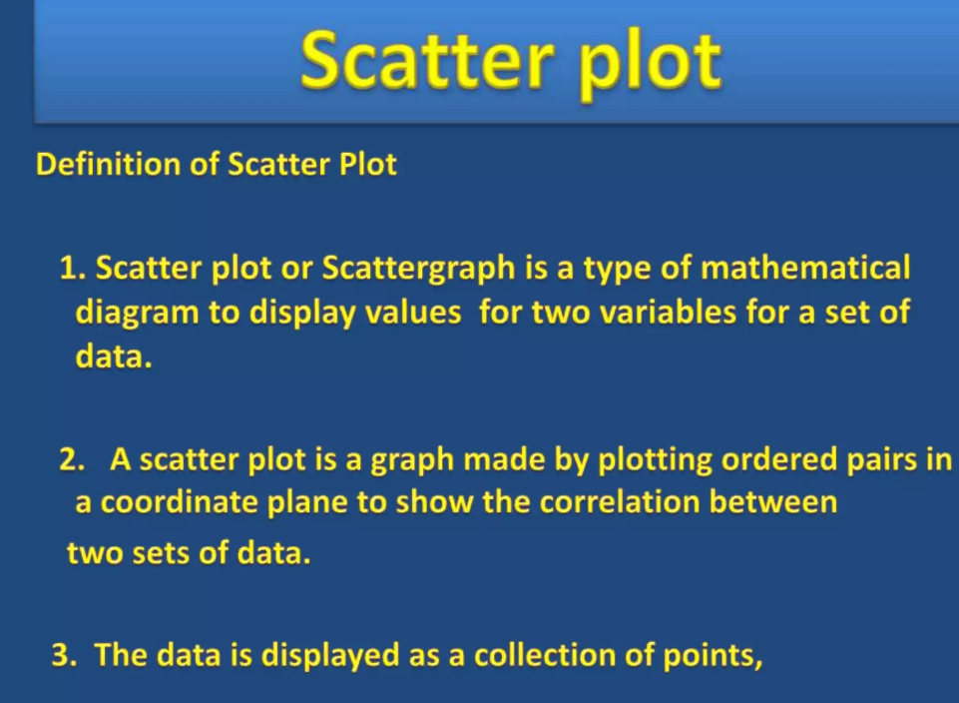

Slide 14
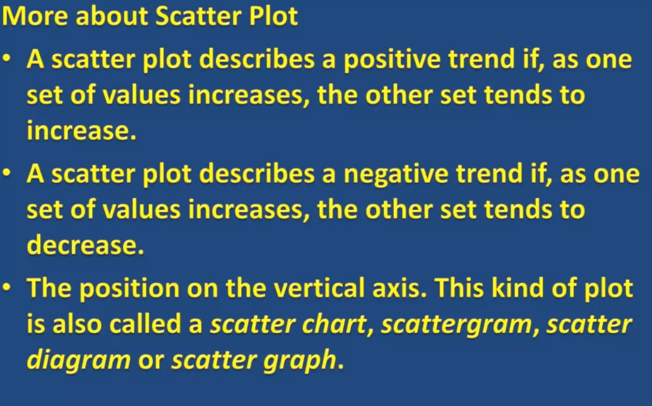

Slide 15
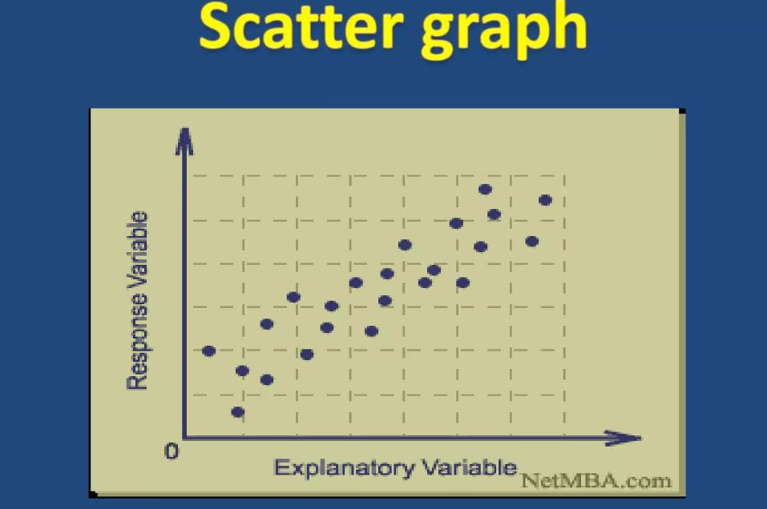

Slide 16
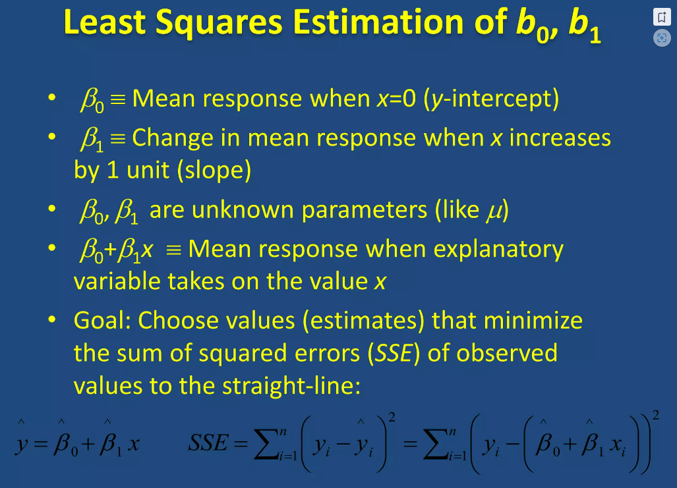

Slide 17
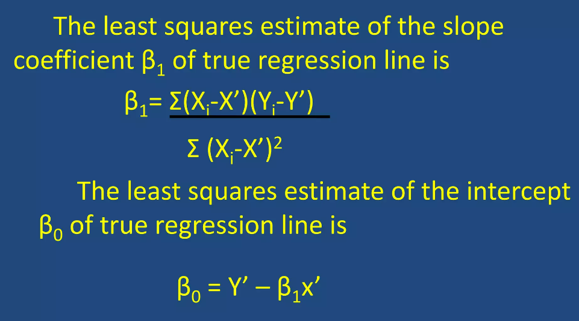

Slide 18
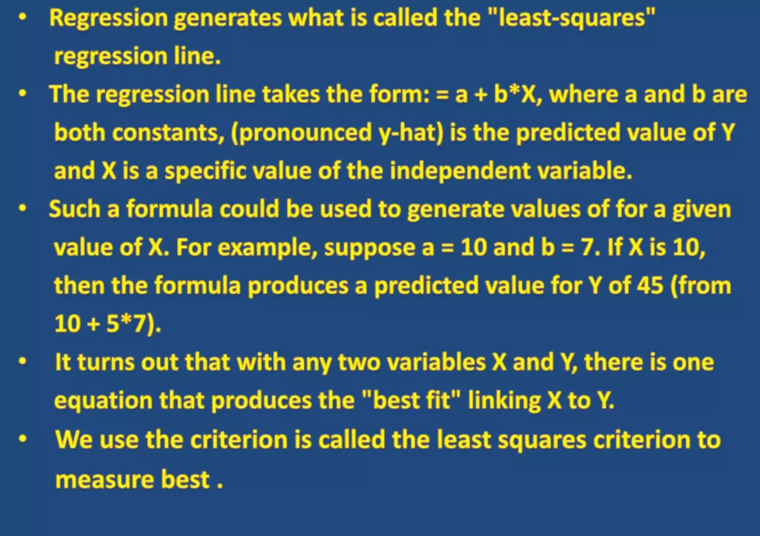

Slide 19
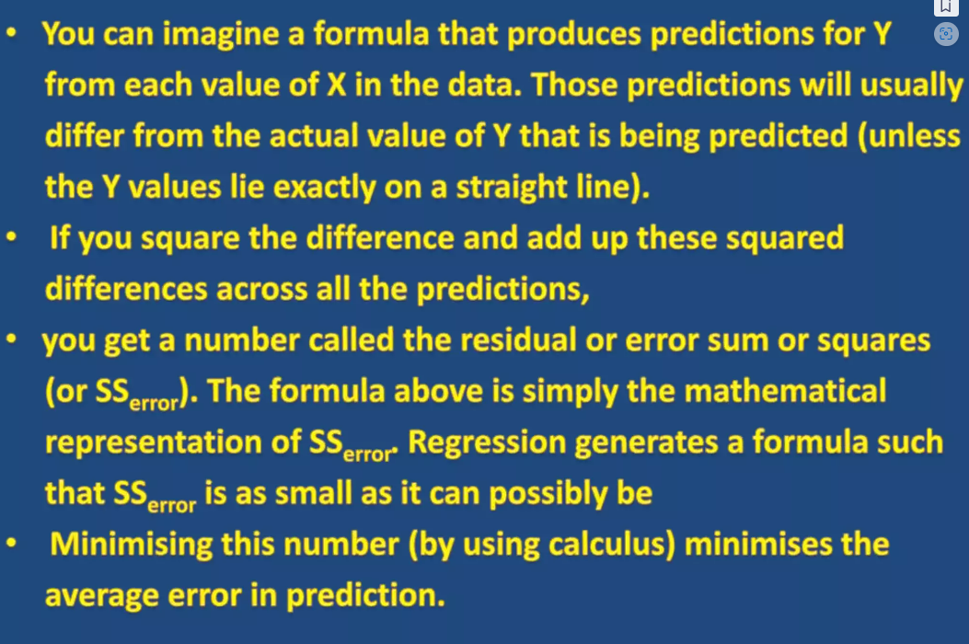

Slide 20
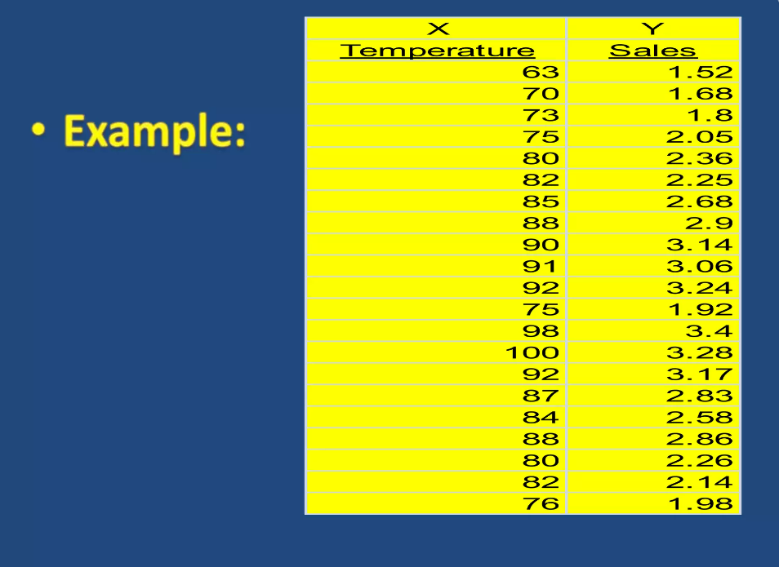

Slide 21
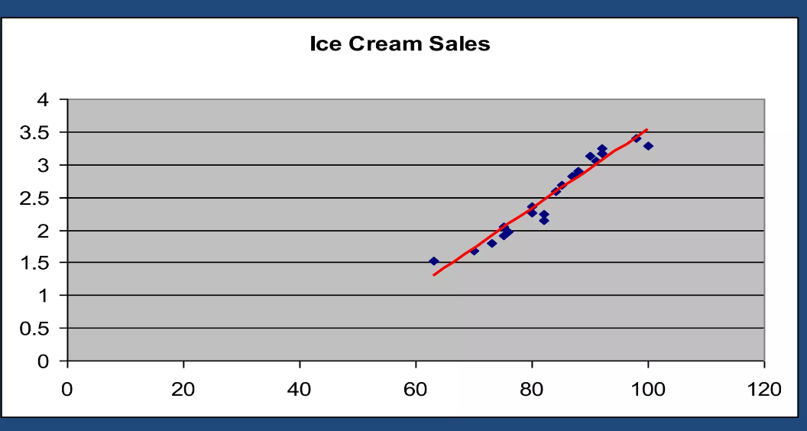

Slide 22
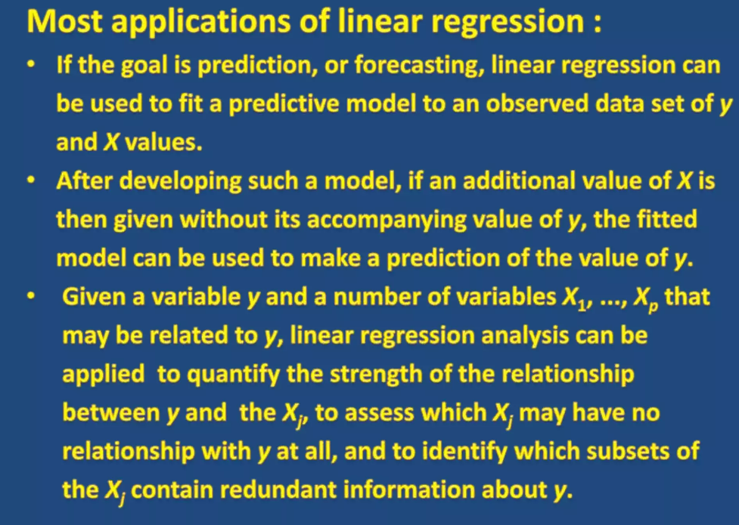

Slide 23
Model Evaluation
Coefficient of Determination (R-squared)
Mean Squared Error (MSE)
Root Mean Squared Error (RMSE)

Slide 24
Linear Regression
COMMON REGRESSION ALGORITHMS
The most common regression algorithms are
Simple linear regression
Multiple linear regression
Polynomial regression
Multivariate adaptive regression splines
Logistic regression
Maximum likelihood estimation (least squares)

Slide 25
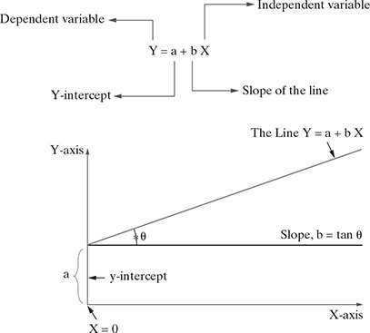
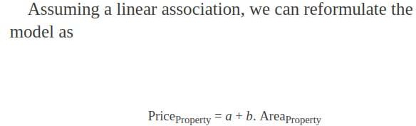
Simple Linear Regression

Slide 26
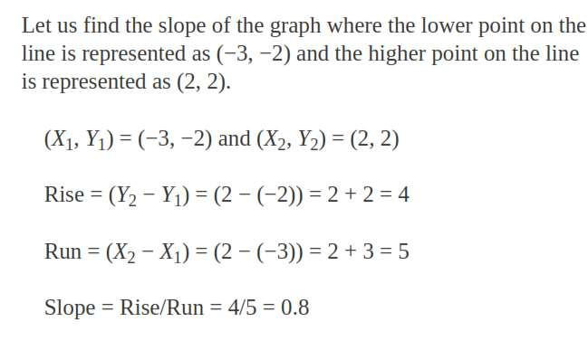
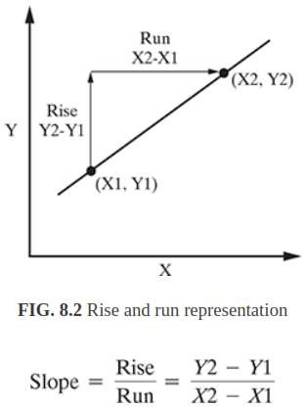
Simple Linear Regression
SLOP
Slope = Change in Y/Change in X
There can be two types of slopes in a linear regression model:
positive slope and negative slope.
Linear positive slope Curve linear positive slope Linear negative slope
Curve linear negative slope

Slide 27
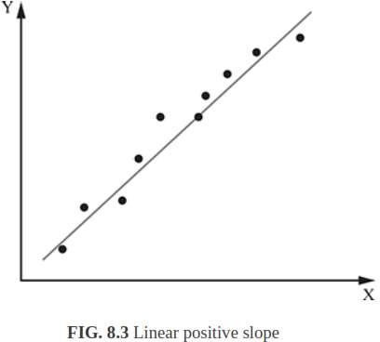
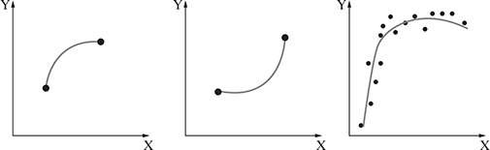
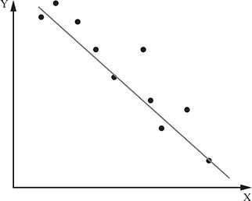
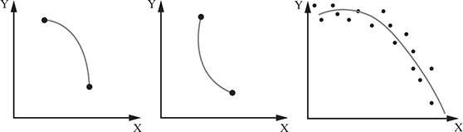
Slop in Linear Regression
A positive slope always moves upward on a graph from left to right
Curve linear positive slope
Linear negative slope
Curve linear negative slope

Slide 28
Logistic regression
Logistic regression is one of the most popular Machine Learning algorithms, which comes under the Supervised Learning technique. It is used for predicting the categorical dependent variable using a given set of independent variables.
Logistic regression predicts the output of a categorical dependent variable. Therefore the outcome must be a categorical or discrete value. It can be either Yes or No, 0 or 1, true or False, etc. but instead of giving the exact value as 0 and 1, it gives the probabilistic values which lie between 0 and 1.
Logistic Regression is much similar to the Linear Regression except that how they are used. Linear Regression is used for solving Regression problems, whereas Logistic regression is used for solving the classification problems.
In Logistic regression, instead of fitting a regression line, we fit an "S" shaped logistic function, which predicts two maximum values (0 or 1).
The curve from the logistic function indicates the likelihood of something such as whether the cells are cancerous or not, a mouse is obese or not based on its weight, etc.
Logistic Regression is a significant machine learning algorithm because it has the ability to provide probabilities and classify new data using continuous and discrete datasets.
Logistic Regression can be used to classify the observations using different types of data and can easily determine the most effective variables used for the classification. The below image is showing the logistic function:

Slide 29

Logistic regression uses the concept of predictive modeling as regression; therefore, it is called logistic regression, but is used to classify samples; Therefore, it falls under the classification algorithm.

Slide 30
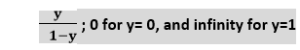
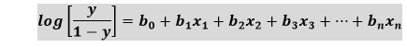
Logistic Function (Sigmoid Function):
The sigmoid function is a mathematical function used to map the predicted values to probabilities.
It maps any real value into another value within a range of 0 and 1.
The value of the logistic regression must be between 0 and 1, which cannot go beyond this limit, so it forms a curve like the "S" form. The S-form curve is called the Sigmoid function or the logistic function.
In logistic regression, we use the concept of the threshold value, which defines the probability of either 0 or 1. Such as values above the threshold value tends to 1, and a value below the threshold values tends to 0.
Assumptions for Logistic Regression:
The dependent variable must be categorical in nature.
The independent variable should not have multi-collinearity.
Logistic Regression Equation:
The Logistic regression equation can be obtained from the Linear Regression equation. The mathematical steps to get Logistic Regression equations are given below:
We know the equation of the straight line can be written as:
In Logistic Regression y can be between 0 and 1 only, so for this let's divide the above equation by (1-y):
But we need range between -[infinity] to +[infinity], then take logarithm of the equation it will become:
The above equation is the final equation for Logistic Regression.

Slide 31
Type of Logistic Regression:
On the basis of the categories, Logistic Regression can be classified into three types:
Binomial: In binomial Logistic regression, there can be only two possible types of the dependent variables, such as 0 or 1, Pass or Fail, etc.
Multinomial: In multinomial Logistic regression, there can be 3 or more possible unordered types of the dependent variable, such as "cat", "dogs", or "sheep"
Ordinal: In ordinal Logistic regression, there can be 3 or more possible ordered types of dependent variables, such as "low", "Medium", or "High".
Steps in Logistic Regression: To implement the Logistic Regression using Python, we will use the same steps as we have done in previous topics of Regression. Below are the steps:
Data Pre-processing step
Fitting Logistic Regression to the Training set
Predicting the test result
Test accuracy of the result(Creation of Confusion matrix)
Visualizing the test set result.

Slide 32
Assumptions of Logistic Regression
We will explore the assumptions of logistic regression as understanding these assumptions is important to ensure that we are using appropriate application of the model. The assumption include:
Independent observations: Each observation is independent of the other. meaning there is no correlation between any input variables.
Binary dependent variables: It takes the assumption that the dependent variable must be binary or dichotomous, meaning it can take only two values. For more than two categories SoftMax functions are used.
Linearity relationship between independent variables and log odds: The relationship between the independent variables and the log odds of the dependent variable should be linear.
No outliers: There should be no outliers in the dataset.
Large sample size: The sample size is sufficiently large

Slide 33
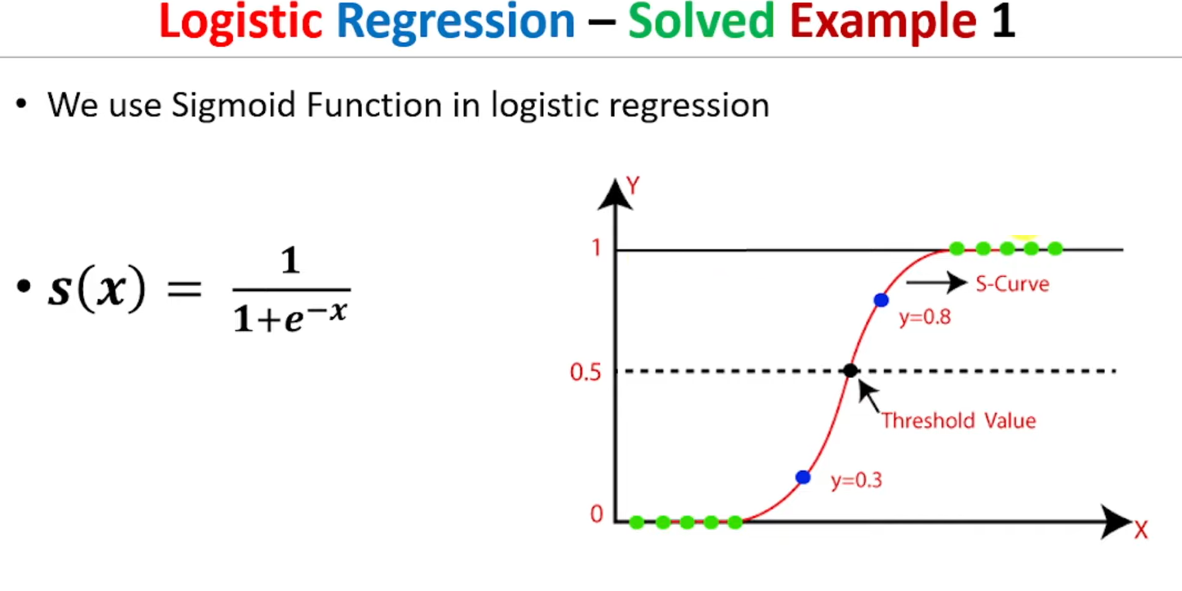

Slide 34
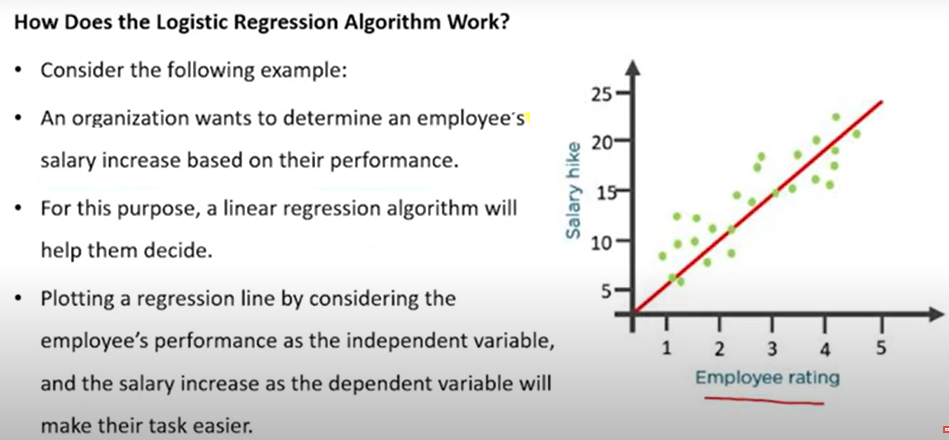

Slide 35
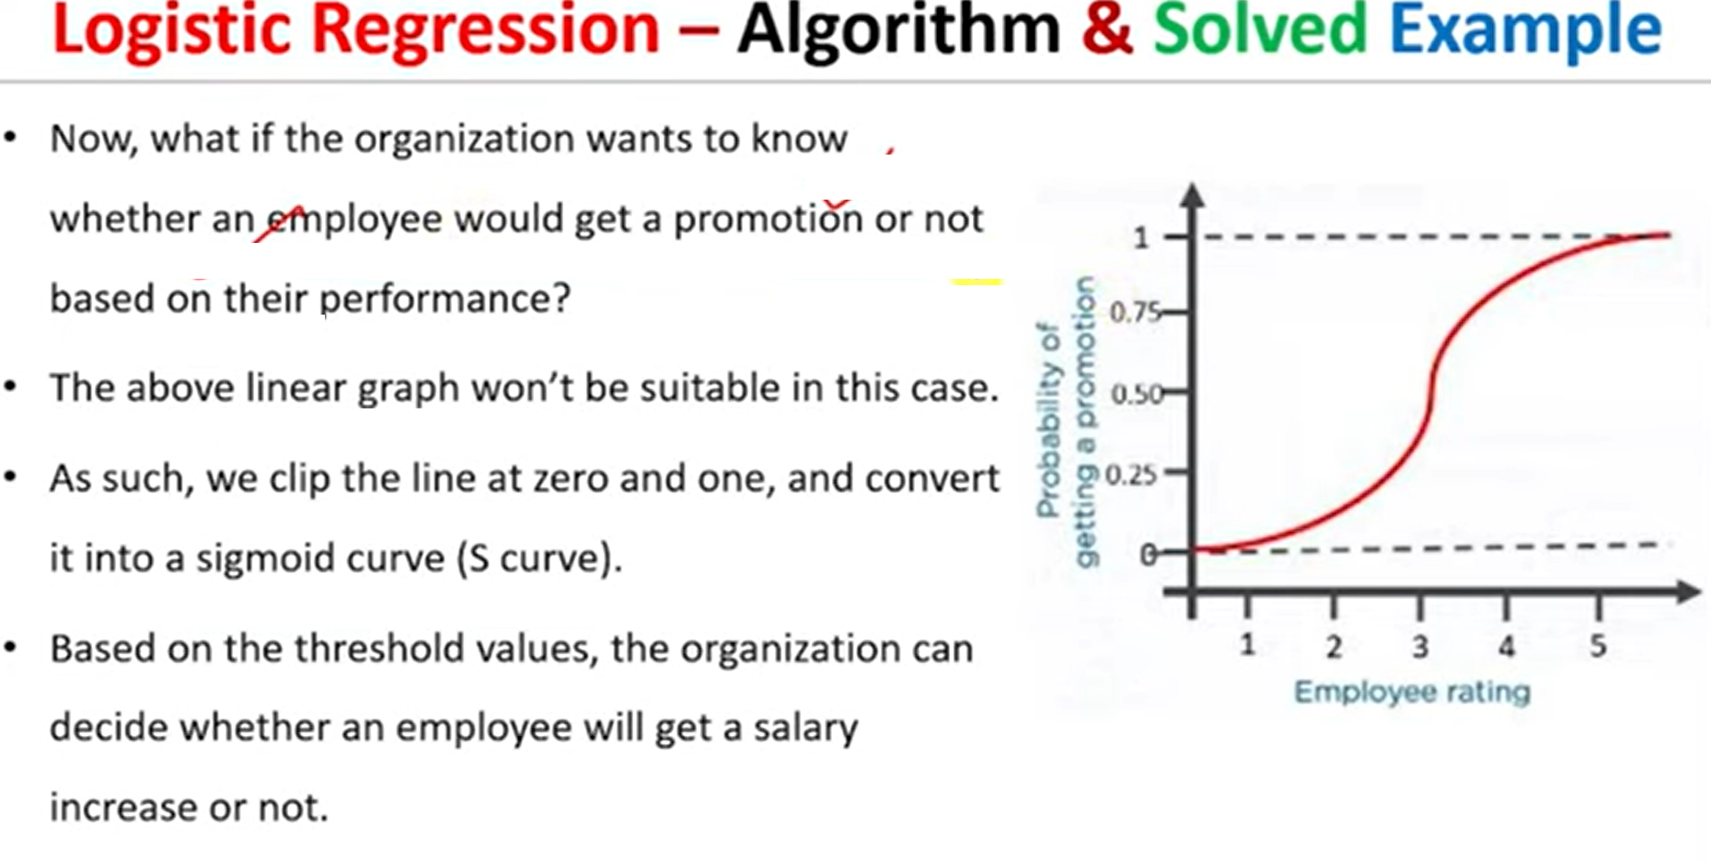

Slide 36
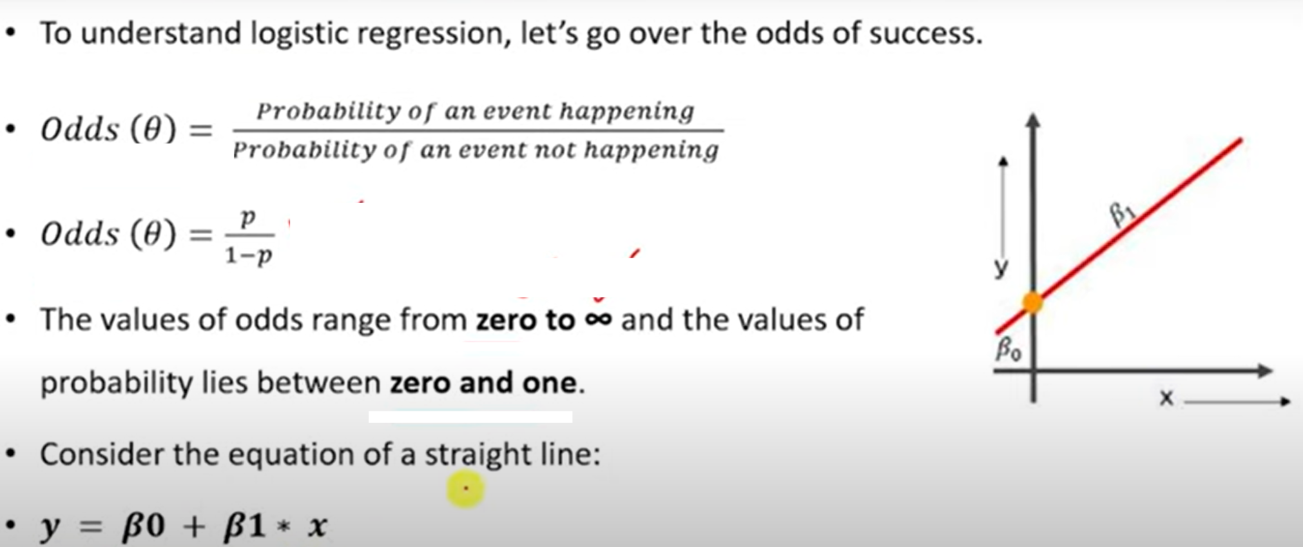

Slide 37
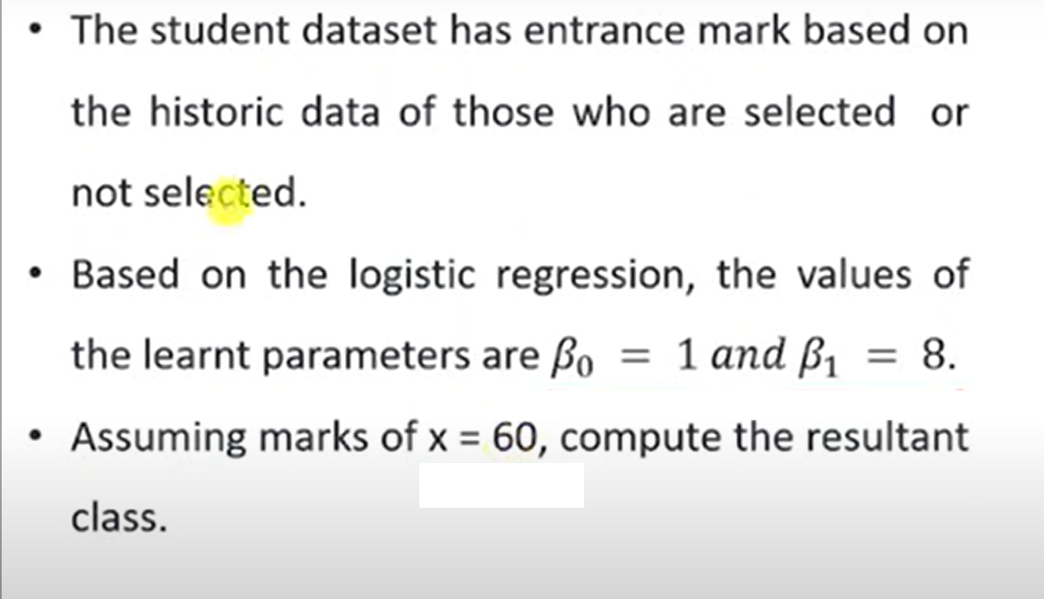

Slide 38
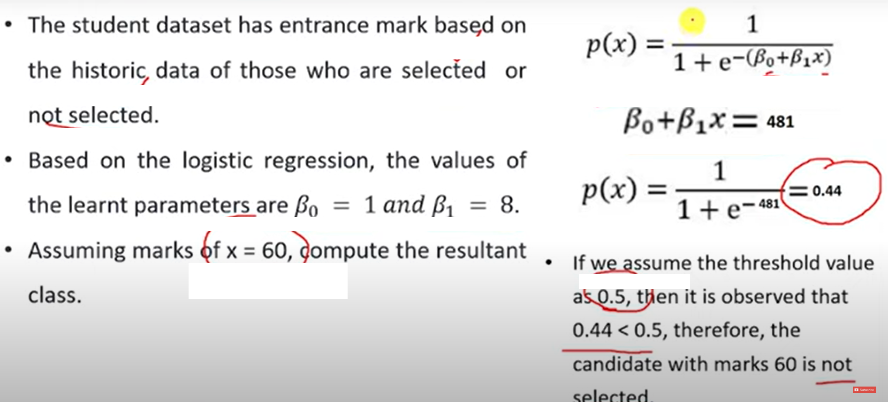

Slide 39
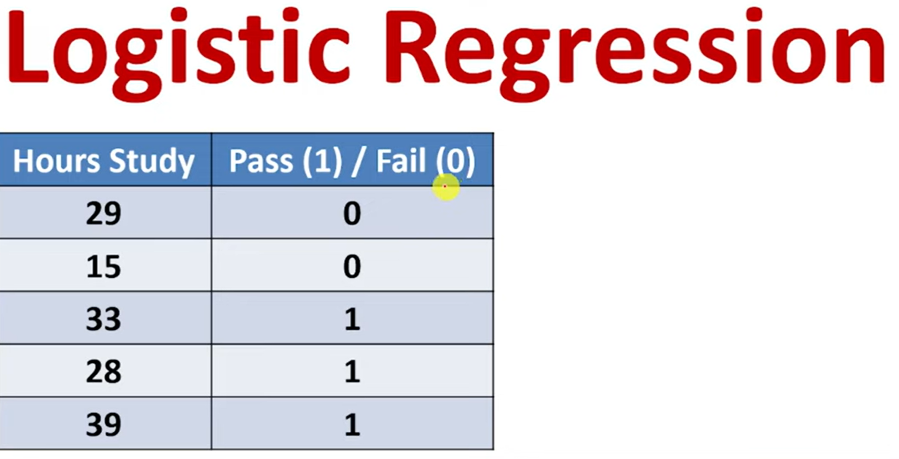

Slide 40
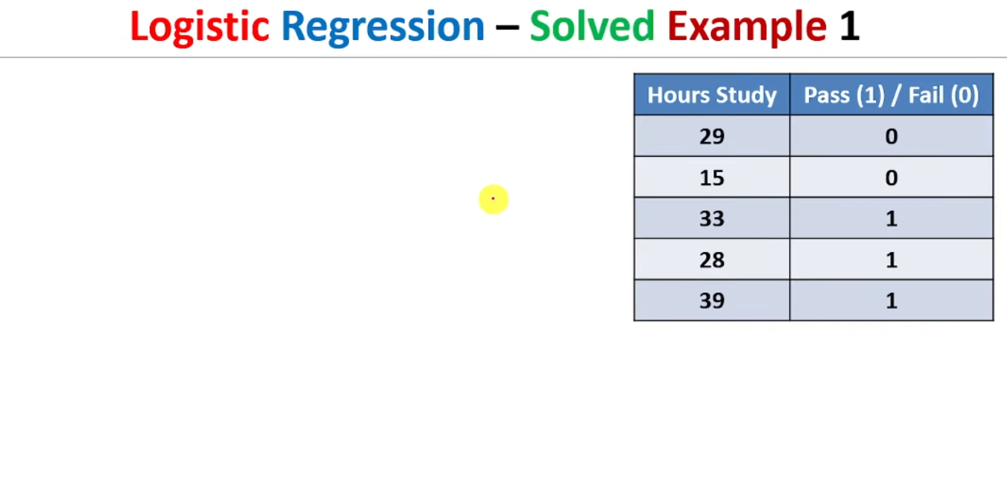
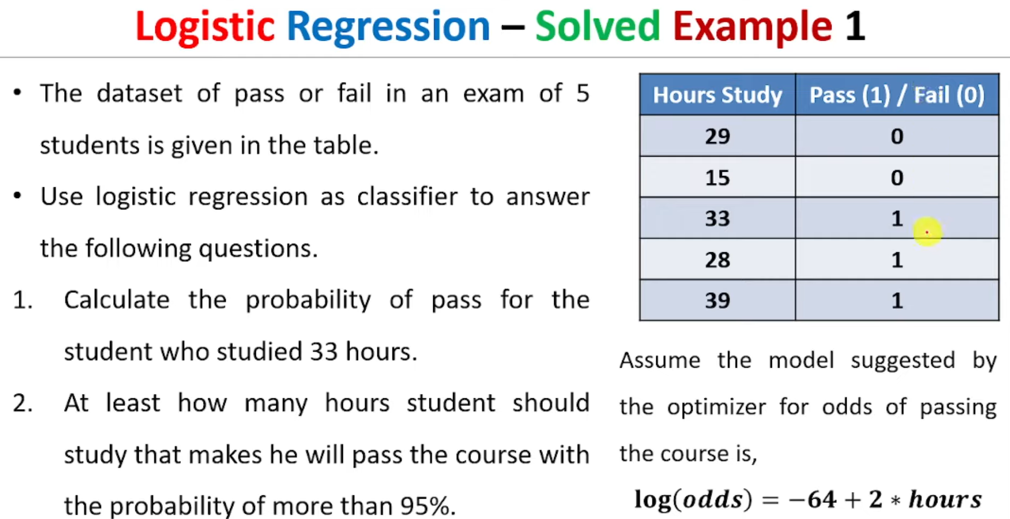

Slide 41
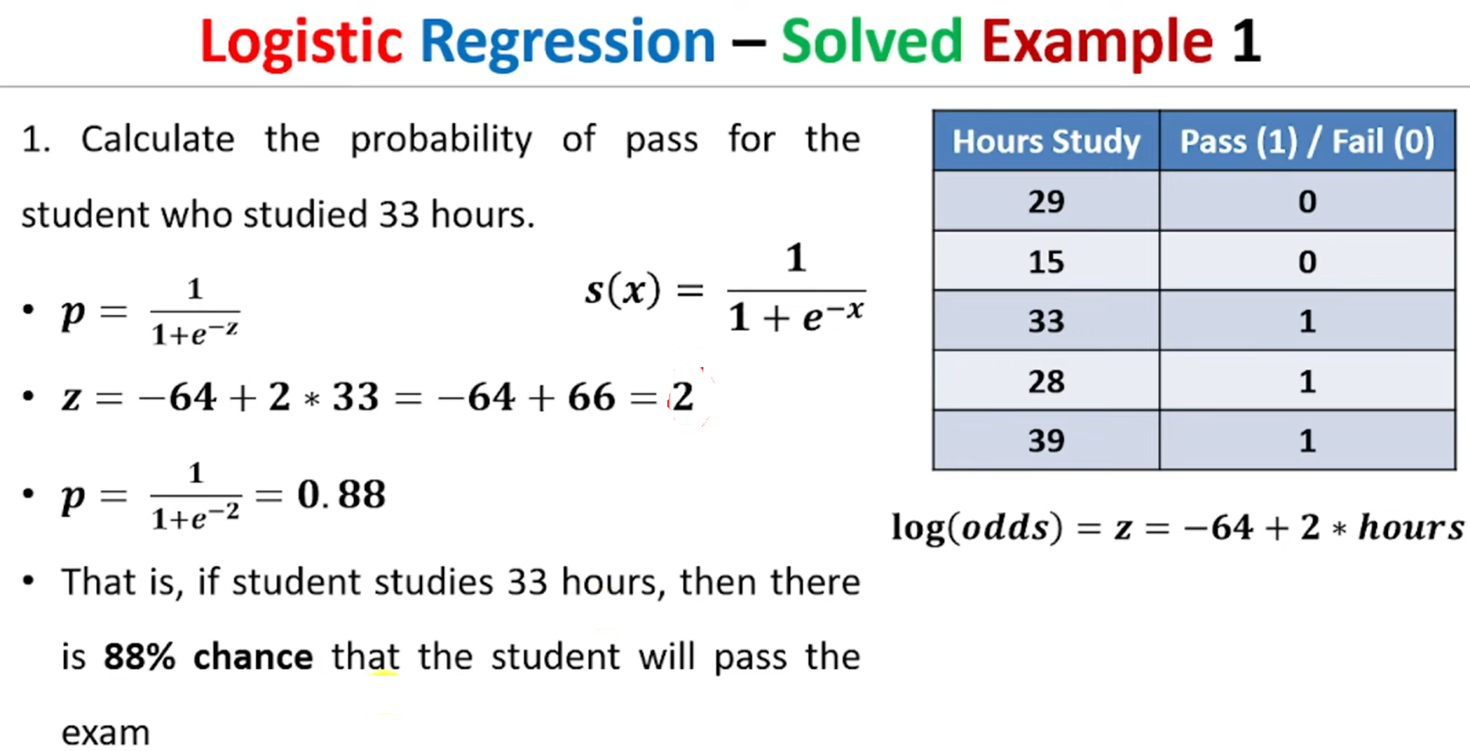

Slide 42
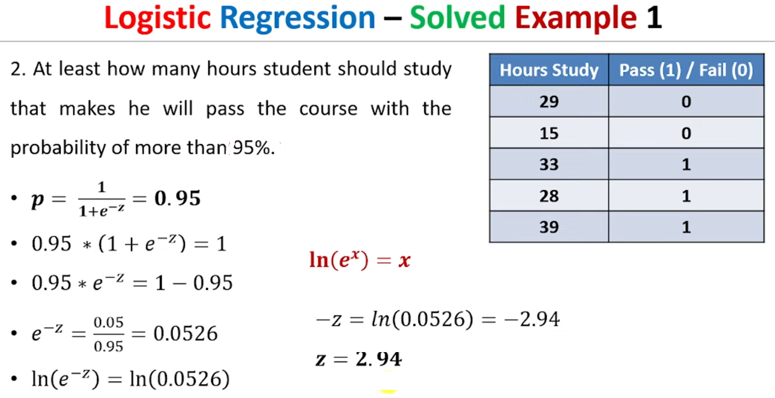

Slide 43
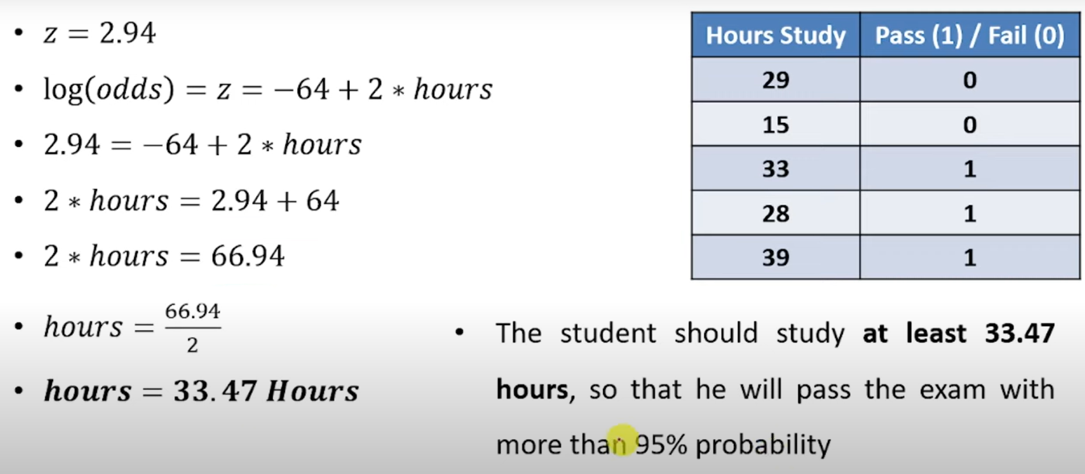

Slide 44
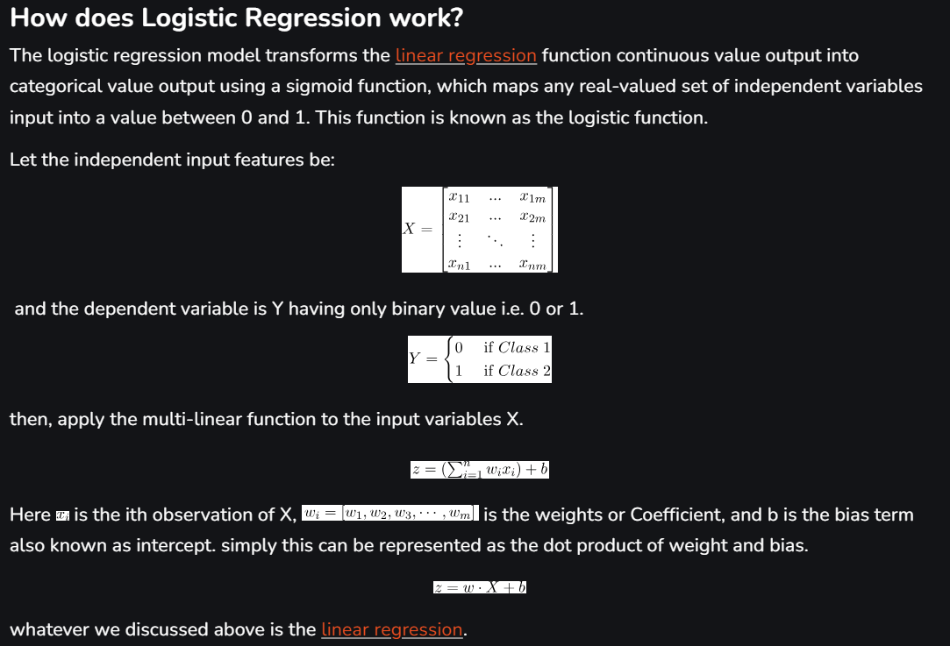

Slide 45
Differences Between Linear and Logistic Regression
The difference between linear regression and logistic regression is that linear regression output is the continuous value that can be anything while logistic regression predicts the probability that an instance belongs to a given class or not.

Slide 46
d
Linear Regression | Logistic Regression
Linear regression is used to predict the continuous dependent variable using a given set of independent variables. | Logistic regression is used to predict the categorical dependent variable using a given set of independent variables.
Linear regression is used for solving regression problem. | It is used for solving classification problems.
In this we predict the value of continuous variables | In this we predict values of categorical variables
In this we find best fit line. | In this we find S-Curve.
Least square estimation method is used for estimation of accuracy. | Maximum likelihood estimation method is used for Estimation of accuracy.
The output must be continuous value, such as price, age, etc. | Output must be categorical value such as 0 or 1, Yes or no, etc.
It required linear relationship between dependent and independent variables. | It not required linear relationship.
There may be collinearity between the independent variables. | There should not be collinearity between independent variables.

Slide 47
Strengths of decision tree
It produces very simple understandable rules. For smaller trees, not much
mathematical and computational knowledge is required to understand this model.
Works well for most of the problems.
It can handle both numerical and categorical variables.
Can work well both with small and large training data sets.
Decision trees provide a definite clue of which features are more useful for classification.

Slide 48
Weaknesses of decision tree
Decision tree models are often biased towards features having more number of possible values, i.e. levels.
This model gets overfitted or underfitted quite easily.
Decision trees are prone to errors in classification problems with many classes and relatively small number of training examples.
A decision tree can be computationally expensive to train.
Large trees are complex to understand

Slide 49
Rule-Based Classifier
Rule-based classifiers are just another type of classifier which makes the class decision depending by using various “if..else” rules.
The condition used with “if” is called the antecedent and the predicted class of each rule is called the consequent.

Slide 50
Rule-Based Classifier
Properties of rule-based classifiers:
Coverage: The percentage of records which satisfy the antecedent conditions of a particular rule.
The rules generated by the rule-based classifiers are generally not mutually exclusive, i.e. many rules can cover the same record.
The rules generated by the rule-based classifiers may not be exhaustive, i.e. there may be some records which are not covered by any of the rules.
The decision boundaries created by them is linear, but these can be much more complex than the decision tree because the many rules are triggered for the same record.

Slide 51
Rule-Based Classifier
An obvious question, which comes into the mind after knowing that the rules are not mutually exclusive is that how would the class be decided in case different rules with different consequent cover the record.
There are two solutions to the above problem:
Either rules can be ordered, i.e. the class corresponding to the highest priority rule triggered is taken as the final class.
Otherwise, we can assign votes for each class depending on some their weights, i.e. the rules remain unordered.

Slide 52
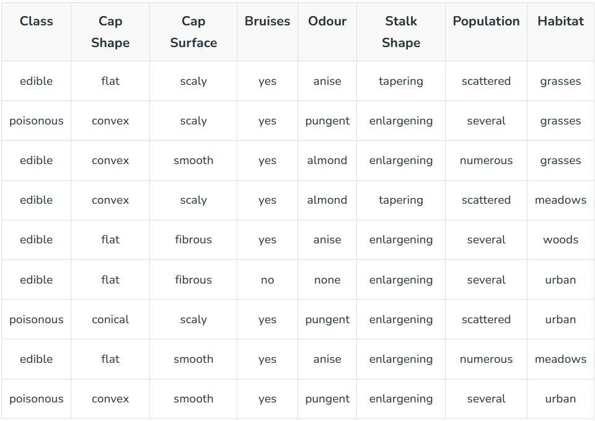
Example: Below is the dataset to classify mushrooms as edible or poisonous:

Slide 53
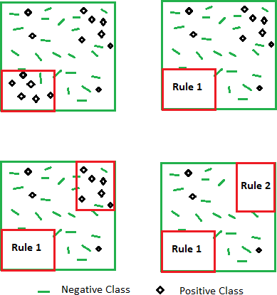
Rule-Based Classifier
Rules: Odour = pungent and habitat = urban -> Class = poisonous
Bruises = yes -> Class = edible :
This rules covers both negative and positive records. The given rules are not mutually exclusive.

Slide 54
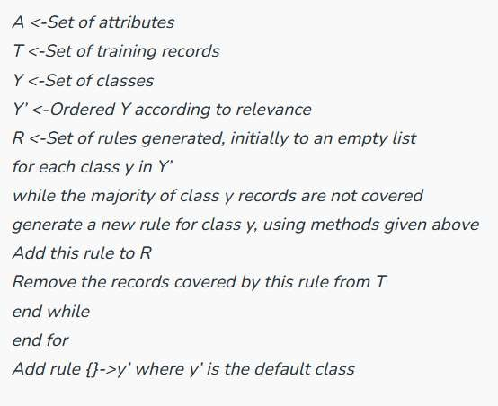
Algorithm for generating the model incrementally:

Slide 55
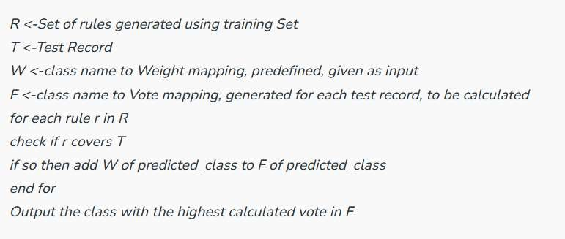
Classifying a record:

Slide 56
Once a decision tree has been constructed, it is a simple matter to convert it into an equivalent set of
rules.
Rule Generation
Converting a decision tree to rules before pruning has three main advantages:
Converting to rules allows distinguishing among the different contexts in which a decision node is used.
Since each distinct path through the decision tree node produces a distinct rule, the pruning
decision regarding that attribute test can be made differently for each path.
In contrast, if the tree itself were pruned, the only two choices would be:
Remove the decision node completely, or
Retain it in its original form.
Converting to rules removes the distinction between attribute tests that occur near the root of the tree and those that occur near the leaves.
We thus avoid messy bookkeeping issues such as how to reorganize the tree if the root node
is pruned while retaining part of the subtree below this test.
Converting to rules improves readability.
Rules are often easier for people to understand.
To generate rules, trace each path in the decision tree, from root node to leaf node, recording the test
outcomes as antecedents and the leaf-node classification as the consequent.

Slide 57
Rule Simplification Overview
Once a rule set has been devised:
Eliminate unecessary rule antecedents to simplify the rules.
Construct contingency tables for each rule consisting of more than one antecedent.
§ Rules with only one antecedent cannot be further simplified, so we only consider those with two or more.
To simplify a rule, eliminate antecedents that have no effect on the conclusion reached by the rule.
A conclusion's independence from an antecendent is verified using a test for independence, which is
§ a chi-square test if the expected cell frequencies are greater than 10.
§ Yates' Correction for Continuity when the expected frequencies are between 5 and 10.
§ Fisher's Exact Test for expected frequencies less than 5.
Eliminate unecessary rules to simplify the rule set.
Once individual rules have been simplified by eliminating redundant antecedents, simplify the entire set by
eliminating unecessary rules.
Attempt to replace those rules that share the most common consequent by a default rule that is triggered when
no other rule is triggered.
§ In the event of a tie, use some heuristic tie breaker to choose a default rule.

Slide 58
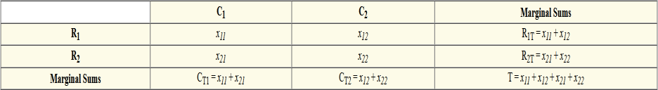
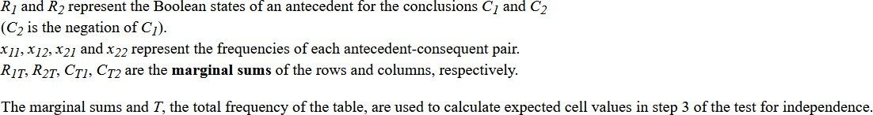
Contingency Tables
The following is a contingency table, a tabular representation of a rule.

Slide 59
Rule-Based Classifier
Classify records by using a collection of “if…then…” rules
Rule: (Condition) → y
where
Condition is a conjunctions of attributes
y is the class label
LHS: rule antecedent or pre condition
RHS: rule consequent
Rules : R=(R1∨R2 ∨… ∨ Rk)
Examples of classification rules:
(Blood Type=Warm) ∧ (Lay Eggs=Yes) → Birds
(Taxable Income < 50K) ∧ (Refund=Yes) → Evade=No

Slide 60
Rule-based Classifier (Example) for Vertebrate Classification Problem
Name | Blood Type | Give Birth | Can Fly | Live in Water | Class
human | warm | yes | no | no | mammals
python | cold | no | no | no | reptiles
salmon | cold | no | no | yes | fishes
whale | warm | yes | no | yes | mammals
frog | cold | no | no | sometimes | amphibians
komodo | cold | no | no | no | reptiles
bat | warm | yes | yes | no | mammals
pigeon | warm | no | yes | no | birds
cat | warm | yes | no | no | mammals
leopard shark | cold | yes | no | yes | fishes
turtle | cold | no | no | sometimes | reptiles
penguin | warm | no | no | sometimes | birds
porcupine | warm | yes | no | no | mammals
eel | cold | no | no | yes | fishes
salamander | cold | no | no | sometimes | amphibians
gila monster | cold | no | no | no | reptiles
platypus | warm | no | no | no | mammals
owl | warm | no | yes | no | birds
dolphin | warm | yes | no | yes | mammals
eagle | warm | no | yes | no | birds
R1: (Give Birth = no) ∧ (Can Fly = yes) → Birds
R2: (Give Birth = no) ∧ (Live in Water = yes) → Fishes
R3: (Give Birth = yes) ∧ (Blood Type = warm) → Mammals R4: (Give Birth = no) ∧ (Can Fly = no) → Reptiles
R5: (Live in Water = sometimes) → Amphibians

Slide 61
Application of Rule-Based Classifier
A rule r covers a record x if the attributes of the record satisfy the condition of the rule. Rule r is also said to be triggered or fired whenever it covers a given record.
R1: (Give Birth = no) ∧ (Can Fly = yes) → Birds
R2: (Give Birth = no) ∧ (Live in Water = yes) → Fishes
R3: (Give Birth = yes) ∧ (Blood Type = warm) → Mammals R4: (Give Birth = no) ∧ (Can Fly = no) → Reptiles
R5: (Live in Water = sometimes) → Amphibians
Name | Blood Type | Give Birth | Can Fly | Live in Water | Class
hawk | warm | no | yes | no | ?
grizzly bear | warm | yes | no | no | ?
The rule R1 covers a hawk => Bird
The rule R3 covers the grizzly bear => Mammal

Slide 62
Rule Coverage and Accuracy
Coverage of a rule:
Fraction of records that satisfy the antecedent of a rule
Accuracy of a rule:
Fraction of records that satisfy both the antecedent and consequent of a rule
Tid | Refund | Marital Status | Taxable Income | Class
1 | Yes | Single | 125K | No
2 | No | Married | 100K | No
3 | No | Single | 70K | No
4 | Yes | Married | 120K | No
5 | No | Divorced | 95K | Yes
6 | No | Married | 60K | No
7 | Yes | Divorced | 220K | No
8 | No | Single | 85K | Yes
9 | No | Married | 75K | No
10 | No | Single | 90K | Yes
10
(Status=Single) → No
Coverage = 40%, Accuracy = 50%

Slide 63
How does Rule-based Classifier Work?
R1: (Give Birth = no) ∧ (Can Fly = yes) → Birds
R2: (Give Birth = no) ∧ (Live in Water = yes) → Fishes
R3: (Give Birth = yes) ∧ (Blood Type = warm) → Mammals
R4: (Give Birth = no) ∧ (Can Fly = no) → Reptiles
R5: (Live in Water = sometimes) → Amphibians
Name | Blood Type | Give Birth | Can Fly | Live in Water | Class
lemur | warm | yes | no | no | ?
turtle | cold | no | no | sometimes | ?
dogfish shark | cold | yes | no | yes | ?
A lemur triggers rule R3, so it is classified as a mammal
A turtle triggers both R4 and R5
A dogfish shark triggers none of the rules

Slide 64
Characteristics of Rule-Based Classifier
Mutually exclusive rules
Classifier contains mutually exclusive rules if no two rules are triggered by the same record.
Every record is covered by at most one rule
Exhaustive rules
Classifier has exhaustive coverage if it accounts for every possible combination of attribute values
Each record is covered by at least one rule

Slide 65
From Decision Trees To Rules
Classification Rules
(Refund=Yes) ==> No
(Refund=No, Marital Status={Single,Divorced},
Taxable Income<80K) ==> No
(Refund=No, Marital Status={Single,Divorced},
Taxable Income>80K) ==> Yes
(Refund=No, Marital Status={Married}) ==> No
Refund
Yes
No
NO
Marital Status
{Single, Divorced}
{Married}
Taxable Income
NO
< 80K
> 80K
NO
YES
Rules are mutually exclusive and exhaustive
Rule set contains as much information as the tree

Slide 66
Rules Can Be Simplified
Tid | Refund | Marital Status | Taxable Income | Cheat
1 | Yes | Single | 125K | No
2 | No | Married | 100K | No
3 | No | Single | 70K | No
4 | Yes | Married | 120K | No
5 | No | Divorced | 95K | Yes
6 | No | Married | 60K | No
7 | Yes | Divorced | 220K | No
8 | No | Single | 85K | Yes
9 | No | Married | 75K | No
10 | No | Single | 90K | Yes
Refund
Yes
No
NO
Marital Status
{Single, Divorced}
{Married}
Taxable Income
NO
< 80K
> 80K
NO
YES
10
Initial Rule: Simplified Rule:
(Refund=No) ∧ (Status=Married) → No (Status=Married) → No

Slide 67
Effect of Rule Simplification
Rules are no longer mutually exclusive
A record may trigger more than one rule
Solution?
Ordered rule set
Unordered rule set – use voting schemes
Rules are no longer exhaustive
A record may not trigger any rules
Solution?
Use a default class

Slide 68
Ordered Rule Set
Rules are rank ordered according to their priority
An ordered rule set is known as a decision list
When a test record is presented to the classifier
It is assigned to the class label of the highest ranked rule it has triggered
If none of the rules fired, it is assigned to the default class
R1: (Give Birth = no) ∧ (Can Fly = yes) → Birds
R2: (Give Birth = no) ∧ (Live in Water = yes) → Fishes
R3: (Give Birth = yes) ∧ (Blood Type = warm) → Mammals R4: (Give Birth = no) ∧ (Can Fly = no) → Reptiles
R5: (Live in Water = sometimes) → Amphibians
Name | Blood Type | Give Birth | Can Fly | Live in Water | Class
turtle | cold | no | no | sometimes | ?

Slide 69
Rule Ordering Schemes
Rule-based ordering
Individual rules are ranked based on their quality
Class-based ordering
Rules that belong to the same class appear together
Rule-based Ordering
(Refund=Yes) ==> No
(Refund=No, Marital Status={Single,Divorced},
Taxable Income<80K) ==> No
(Refund=No, Marital Status={Single,Divorced},
Taxable Income>80K) ==> Yes
(Refund=No, Marital Status={Married}) ==> No
Class-based Ordering
(Refund=Yes) ==> No
(Refund=No, Marital Status={Single,Divorced},
Taxable Income<80K) ==> No
(Refund=No, Marital Status={Married}) ==> No
(Refund=No, Marital Status={Single,Divorced}, Taxable Income>80K) ==> Yes

Slide 70
Building Classification Rules
Direct Method:
Extract rules directly from data
e.g.: RIPPER, CN2, Holte’s 1R
Indirect Method:
Extract rules from other classification models (e.g. decision trees, neural networks, etc).
e.g: C4.5rules

Slide 71
Direct Method: Sequential Covering
Start from an empty rule
Grow a rule using the Learn-One-Rule function
Remove training records covered by the rule
Repeat Step (2) and (3) until stopping criterion is met

Slide 72
Example of Sequential Covering
(i) Original Data
(ii) Step 1

Slide 73
Example of Sequential Covering…
R1
R1
R2
(iii) Step 2
(iv) Step 3

Slide 74
Aspects of Sequential Covering
Rule Growing
Instance Elimination
Rule Evaluation
Stopping Criterion
Rule Pruning

Slide 75
Rule Growing
Two common strategies
Yes: 3
No: 4
{ }
Refund=No, Status=Single, Income=85K (Class=Yes)
Refund=No, Status=Single, Income=90K (Class=Yes)
...
Refund= No
Status = Single
Status = Divorced
Status = Married
Income
> 80K
Refund=No, Status = Single (Class = Yes)
Yes: 3
No: 4
Yes: 2
No: 1
Yes: 1
No: 0
Yes: 0
No: 3
Yes: 3
No: 1
(a) General-to-specific
(b) Specific-to-general

Slide 76
Rule Growing (Examples)
CN2 Algorithm:
Start from an empty conjunct: {}
Add conjuncts that minimizes the entropy measure: {A}, {A,B}, …
Determine the rule consequent by taking majority class of instances covered by the rule
RIPPER Algorithm:
Start from an empty rule: {} => class
Add conjuncts that maximizes FOIL’s information gain measure:
R0: {} => class (initial rule)
R1: {A} => class (rule after adding conjunct)
Gain(R0, R1) = t [ log (p1/(p1+n1)) – log (p0/(p0 + n0)) ]
where t: number of positive instances covered by both R0 and R1
p0: number of positive instances covered by R0 n0: number of negative instances covered by R0 p1: number of positive instances covered by R1 n1: number of negative instances covered by R1

Slide 77
Instance Elimination
Why do we need to eliminate instances?
– Otherwise, the next rule is identical to previous rule
Why do we remove positive instances?
Ensure that the next rule is
different
Why do we remove negative instances?
Prevent underestimating
accuracy of rule
Compare rules R2 and R3 in the diagram
R3
R2
R1
+ + +
+
+
+
+
+
+
+
+ +
+ +
+
+
class = +
₊ ₊ +
+
+
+
+
+ ₊
+
+ +
+
-
-
-
- -
-
- - -
-
class = -
-
-
-
-
-
-
-
-
-
-
-

Slide 78
Rule Evaluation
₌ n_{c}
Metrics:
– Accuracy
n
₌ n_{c} + 1
n : Number of instances
covered by rule
n_{c} : Number of instances covered by rule
k : Number of classes
p : Prior probability
n + k
– Laplace
₌ n_{c} + kp
– M-estimate
n + k

Slide 79
Stopping Criterion and Rule Pruning
Stopping criterion
Compute the gain
If gain is not significant, discard the new rule
Rule Pruning
Similar to post-pruning of decision trees
Reduced Error Pruning:
Remove one of the conjuncts in the rule
Compare error rate on validation set before and after pruning
If error improves, prune the conjunct

Slide 80
Summary of Direct Method
Grow a single rule
Remove Instances from rule
Prune the rule (if necessary)
Add rule to Current Rule Set
Repeat

Slide 81
Direct Method: RIPPER
For 2-class problem, choose one of the classes as positive class, and the other as negative class
Learn rules for positive class
Negative class will be default class
For multi-class problem
Order the classes according to increasing class prevalence (fraction of instances that belong to a particular class)
Learn the rule set for smallest class first, treat the rest as negative class
Repeat with next smallest class as positive class

Slide 82
Direct Method: RIPPER
Growing a rule:
Start from empty rule
Add conjuncts as long as they improve FOIL’s information gain
Stop when rule no longer covers negative examples
Prune the rule immediately using incremental reduced
error pruning
Measure for pruning: v = (p-n)/(p+n)
p: number of positive examples covered by the rule in
the validation set
n: number of negative examples covered by the rule in the validation set
Pruning method: delete any final sequence of conditions that maximizes v

Slide 83
Direct Method: RIPPER
Building a Rule Set:
Use sequential covering algorithm
Finds the best rule that covers the current set of positive examples
Eliminate both positive and negative examples covered
by the rule
Each time a rule is added to the rule set, compute the new description length
stop adding new rules when the new description length is d bits longer than the smallest description length obtained so far

Slide 84
Direct Method: RIPPER
Optimize the rule set:
For each rule r in the rule set R
Consider 2 alternative rules:
Replacement rule (r*): grow new rule from scratch
Revised rule(r’): add conjuncts to extend the rule r
Compare the rule set for r against the rule set for r* and r’
Choose rule set that minimizes MDL principle
Repeat rule generation and rule optimization for the remaining positive examples

Slide 85
Indirect Methods
P
No
Yes
Rule Set
r1: (P=No,Q=No) ==> - r2: (P=No,Q=Yes) ==> + r3: (P=Yes,R=No) ==> +
r4: (P=Yes,R=Yes,Q=No) ==> - r5: (P=Yes,R=Yes,Q=Yes) ==> +
Q
R
No
Yes
No
Yes
- + +
Q
No
Yes
- +

Slide 86
Indirect Method: C4.5rules
Extract rules from an unpruned decision tree
For each rule, r: A → y,
consider an alternative rule r’: A’ → y where A’ is obtained by removing one of the conjuncts in A
Compare the pessimistic error rate for r against all r’s
Prune if one of the r’s has lower pessimistic error rate
Repeat until we can no longer improve generalization error

Slide 87
Indirect Method: C4.5rules
Instead of ordering the rules, order subsets of rules (class ordering)
Each subset is a collection of rules with the same rule consequent (class)
Compute description length of each subset
Description length = L(error) + g L(model)
g is a parameter that takes into account the presence of redundant attributes in a rule set
(default value = 0.5)

Slide 88
Example
Name | Give Birth | Lay Eggs | Can Fly | Live in Water | Have Legs | Class
human | yes | no | no | no | yes | mammals
python | no | yes | no | no | no | reptiles
salmon | no | yes | no | yes | no | fishes
whale | yes | no | no | yes | no | mammals
frog | no | yes | no | sometimes | yes | amphibians
komodo | no | yes | no | no | yes | reptiles
bat | yes | no | yes | no | yes | mammals
pigeon | no | yes | yes | no | yes | birds
cat | yes | no | no | no | yes | mammals
leopard shark | yes | no | no | yes | no | fishes
turtle | no | yes | no | sometimes | yes | reptiles
penguin | no | yes | no | sometimes | yes | birds
porcupine | yes | no | no | no | yes | mammals
eel | no | yes | no | yes | no | fishes
salamander | no | yes | no | sometimes | yes | amphibians
gila monster | no | yes | no | no | yes | reptiles
platypus | no | yes | no | no | yes | mammals
owl | no | yes | yes | no | yes | birds
dolphin | yes | no | no | yes | no | mammals
eagle | no | yes | yes | no | yes | birds

Slide 89
C4.5rules versus RIPPER
C4.5rules:
(Give Birth=No, Can Fly=Yes) → Birds
Give Birth?
(Give Birth=No, Live in Water=Yes) → Fishes (Give Birth=Yes) → Mammals
(Give Birth=No, Can Fly=No, Live in Water=No)
→ Reptiles
( ) → Amphibians
(Live in Water=Yes) → Fishes
(Have Legs=No) → Reptiles
Can
Yes
No
Mammals
Live In Water?
Yes
No
RIPPER:
Sometimes
Fishes
Amphibians
(Give Birth=No, Can Fly=No, Live In Water=No)
→ Reptiles
(Can Fly=Yes,Give Birth=No) →
Birds
() → Mammals
Fly?
Yes
No
Birds
Reptiles

Slide 90
C4.5rules versus RIPPER
C4.5 and C4.5rules:
 |  |  | PREDICTED CLASS
 |  | Amphibians | Fishes | Reptiles | Birds | Mammals
ACTUAL | Amphibians | 2 | 0 | 0 | 0 | 0
CLASS | Fishes | 0 | 2 | 0 | 0 | 1
 | Reptiles | 1 | 0 | 3 | 0 | 0
 | Birds | 1 | 0 | 0 | 3 | 0
 | Mammals | 0 | 0 | 1 | 0 | 6
RIPPER:
 |  |  | PREDICTED CLASS
 |  | Amphibians | Fishes | Reptiles | Birds | Mammals
ACTUAL | Amphibians | 0 | 0 | 0 | 0 | 2
CLASS | Fishes | 0 | 3 | 0 | 0 | 0
 | Reptiles | 0 | 0 | 3 | 0 | 1
 | Birds | 0 | 0 | 1 | 2 | 1
 | Mammals | 0 | 2 | 1 | 0 | 4

Slide 91
Advantages of Rule-Based Classifiers
As highly expressive as decision trees
Easy to interpret
Easy to generate
Can classify new instances rapidly
Performance comparable to decision trees

Slide 92

Support Vector Machine Algorithm
Support Vector Machine or SVM is one of the most popular Supervised Learning algorithms, which is used for Classification as well as Regression problems. However, primarily, it is used for Classification problems in Machine Learning.
The goal of the SVM algorithm is to create the best line or decision boundary that can segregate n-dimensional space into classes so that we can easily put the new data point in the correct category in the future. This best decision boundary is called a hyperplane.
SVM chooses the extreme points/vectors that help in creating the hyperplane. These extreme cases are called as support vectors, and hence algorithm is termed as Support Vector Machine. Consider the below diagram in which there are two different categories that are classified using a decision boundary or hyperplane:

Slide 93
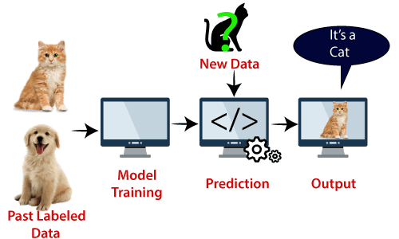
Example: SVM can be understood with the example that we have used in the KNN classifier. Suppose we see a strange cat that also has some features of dogs, so if we want a model that can accurately identify whether it is a cat or dog, so such a model can be created by using the SVM algorithm. We will first train our model with lots of images of cats and dogs so that it can learn about different features of cats and dogs, and then we test it with this strange creature. So as support vector creates a decision boundary between these two data (cat and dog) and choose extreme cases (support vectors), it will see the extreme case of cat and dog. On the basis of the support vectors, it will classify it as a cat. Consider the below diagram:
SVM algorithm can be used for Face detection, image classification, text categorization, etc.

Slide 94
Types of SVM
SVM can be of two types:
Linear SVM: Linear SVM is used for linearly separable data, which means if a dataset can be classified into two classes by using a single straight line, then such data is termed as linearly separable data, and classifier is used called as Linear SVM classifier.
Non-linear SVM: Non-Linear SVM is used for non-linearly separated data, which means if a dataset cannot be classified by using a straight line, then such data is termed as non-linear data and classifier used is called as Non-linear SVM classifier.
Hyperplane and Support Vectors in the SVM algorithm:
Hyperplane: There can be multiple lines/decision boundaries to segregate the classes in n-dimensional space, but we need to find out the best decision boundary that helps to classify the data points. This best boundary is known as the hyperplane of SVM.
The dimensions of the hyperplane depend on the features present in the dataset, which means if there are 2 features (as shown in image), then hyperplane will be a straight line. And if there are 3 features, then hyperplane will be a 2-dimension plane.
We always create a hyperplane that has a maximum margin, which means the maximum distance between the data points.
Support Vectors:

Slide 95


The data points or vectors that are the closest to the hyperplane and which affect the position of the hyperplane are termed as Support Vector. Since these vectors support the hyperplane, hence called a Support vector.
How does SVM works?
Linear SVM:
The working of the SVM algorithm can be understood by using an example. Suppose we have a dataset that has two tags (green and blue), and the dataset has two features x1 and x2. We want a classifier that can classify the pair(x1, x2) of coordinates in either green or blue. Consider the below image:
So as it is 2-d space so by just using a straight line, we can easily separate these two classes. But there can be multiple lines that can separate these classes. Consider the below image:

Slide 96

Hence, the SVM algorithm helps to find the best line or decision boundary; this best boundary or region is called as a hyperplane. SVM algorithm finds the closest point of the lines from both the classes. These points are called support vectors. The distance between the vectors and the hyperplane is called as margin. And the goal of SVM is to maximize this margin. The hyperplane with maximum margin is called the optimal hyperplane.

Slide 97


Non-Linear SVM:
If data is linearly arranged, then we can separate it by using a straight line, but for non-linear data, we cannot draw a single straight line. Consider the below image:
So to separate these data points, we need to add one more dimension. For linear data, we have used two dimensions x and y, so for non-linear data, we will add a third dimension z. It can be calculated as:
z=x² +y²
By adding the third dimension, the sample space will become as below image:
So now, SVM will divide the datasets into classes in the following way. Consider the below image:

Slide 98


Since we are in 3-d Space, hence it is looking like a plane parallel to the x-axis. If we convert it in 2d space with z=1, then it will become as:
Hence we get a circumference of radius 1 in case of non-linear data.

Slide 99
SVM – Support Vector machines

Slide 100



1 D
3 D
2 D

Slide 101


Slide 102

SVM – Support Vector machines

Slide 103
SVM – Support Vector machines
Types of SVM
SVM can be of two types:
Linear SVM: Linear SVM is used for linearly separable data, which means if a dataset can be classified into two classes by using a single straight line, then such data is termed as linearly separable data, and classifier is used called as Linear SVM classifier.
Non-linear SVM: Non-Linear SVM is used for non-linearly separated data, which means if a dataset cannot be classified by using a straight line, then such data is termed as non- linear data and classifier used is called as Non-linear SVM classifier.

Slide 104


Slide 105


Slide 106


Slide 107



SVM – Support Vector machines

Slide 108




SVM – Support Vector machines
Non-Linear SVM:
Z =x2 +y2
3D space
2D space

Slide 109

Why is it called Naïve Bayes?
The Naïve Bayes algorithm is comprised of two words Naïve and Bayes, Which can be described as:
Naïve: It is called Naïve because it assumes that the occurrence of a certain feature is independent of the occurrence of other features. Such as if the fruit is identified on the bases of color, shape, and taste, then red, spherical,
and sweet fruit is recognized as an apple. Hence each feature individually contributes to identify that it is an apple without depending on each other.
Bayes: It is called Bayes because it depends on the principle of Bayes'
Theorem.

Slide 110

Bayes' Theorem:
Bayes' theorem is also known as Bayes' Rule or Bayes' law, which is used to determine the probability of
a hypothesis with prior knowledge. It depends on the conditional probability.
The formula for Bayes' theorem is given as:
Where,
P(A|B) is Posterior probability: Probability of hypothesis A on the observed event B. P(B|A) is Likelihood probability: Probability of the evidence given that the probability of a hypothesis is true.
P(A) is Prior Probability: Probability of hypothesis before observing the evidence.
P(B) is Marginal Probability: Probability of Evidence.

Slide 111
Example
Suppose we have a dataset of weather conditions and corresponding target variable "Play". So using this dataset we need to decide that whether we should play or not on a particular day according to the weather conditions. So to solve this problem, we need to follow the below steps:
Convert the given dataset into frequency tables.
Generate Likelihood table by finding the probabilities of given features.
Now, use Bayes theorem to calculate the posterior probability.

Slide 112

?

Slide 113

Prior Probability

Slide 114


Prior Probability
Conditional Probability

Slide 115


Slide 116
Advantages of Naïve Bayes Classifier:
Naïve Bayes is one of the fast and easy ML algorithms to predict a class of datasets.
It can be used for Binary as well as Multi-class Classifications.
It performs well in Multi-class predictions as compared to the other Algorithms.
It is the most popular choice for text classification problems. Disadvantages of Naïve Bayes Classifier:
Naive Bayes assumes that all features are independent or unrelated, so it cannot learn the
relationship between features.
Applications of Naïve Bayes Classifier:
It is used for Credit Scoring.
It is used in medical data classification.
It can be used in real-time predictions because Naïve Bayes Classifier is an eager learner.
It is used in Text classification such as Spam filtering and Sentiment analysis.

Slide 117
Types of Naïve Bayes Model:
There are three types of Naive Bayes Model, which are given below:
Gaussian: The Gaussian model assumes that features follow a normal distribution. This means if predictors take continuous values instead of discrete, then the model assumes that these
values are sampled from the Gaussian distribution.
Multinomial: The Multinomial Naïve Bayes classifier is used when the data is multinomial distributed. It is primarily used for document classification problems, it means a particular document belongs to which category such as Sports, Politics, education, etc.
The classifier uses the frequency of words for the predictors.
Bernoulli: The Bernoulli classifier works similar to the Multinomial classifier, but the predictor variables are the independent Booleans variables. Such as if a particular word is present or not in a document. This model is also famous for document classification tasks.

Slide 118
Bayesian Belief Networks
Bayesian Belief Network is a graphical representation of different probabilistic relationships among random variables in a particular set.
It is a classifier with no dependency on attributes i.e it is condition independent. Due to its feature of joint probability, the probability in Bayesian Belief Network is derived, based on a condition — P(attribute/parent) i.e probability of an attribute, true over parent attribute.

Slide 119

Bayesian Belief Networks
Consider this example:

Slide 120
Bayesian Belief Networks
Find the probability that ‘P1’ is true (P1 has called ‘RS’), ‘P2’ is true (P2 has called
‘gfg’) when the alarm ‘A’ rang, but no burglary ‘B’ and fire ‘F’ has occurred.
=> P ( P1, P2, A, ~B, ~F) [ where- P1, P2 & A are ‘true’ events and ‘~B’ & ‘~F’ are ‘false’ events]
Burglary ‘B’ –
P (B=T) = 0.001 (‘B’ is true i.e burglary has occurred)
P (B=F) = 0.999 (‘B’ is false i.e burglary has not occurred)
Fire ‘F’ –
P (F=T) = 0.002 (‘F’ is true i.e fire has occurred)
P (F=F) = 0.998 (‘F’ is false i.e fire has not occurred)

Slide 121



Bayesian Belief Networks
Alarm ‘A’ –
Person ‘P1’ –
With respect to the question —
P ( P1, P2, A, ~B, ~F) , we need to
get the probability
P ( P1, P2, A, ~B, ~F)
= P (P1/A) * P (P2/A) * P (A/~B~F) * P (~B) * P (~F)
Person ‘P2’ –
= 0.95 * 0.80 * 0.001 * 0.999 * 0.998
= 0.00075

